Slide 1
Chapter 1
Introduction

Slide 2
The Contents of Chapter 1
3 questions about digital image processing
What is an image?
What is a digital image?
What is digital image processing?
An introduction to programming of digital image processing
Applications of digital image processing

Slide 3
1.1 Basic Concepts
1.1.1 What is an Image?
photograph == Image?

Slide 4

Sample of Photograph
Human being
Lena: most famous picture in the field of Digital Image Processing

Slide 5
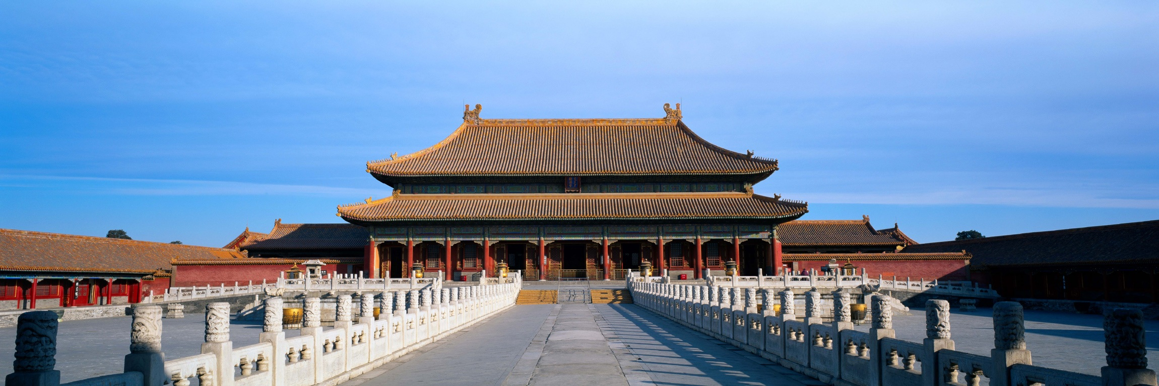
Sample of Photographs
Forbidden City (Architecture)

Slide 6

Sample of Photographs
the Huashan Mountain (Landscape)

Slide 7


Sample of Photographs
Flower

Slide 8
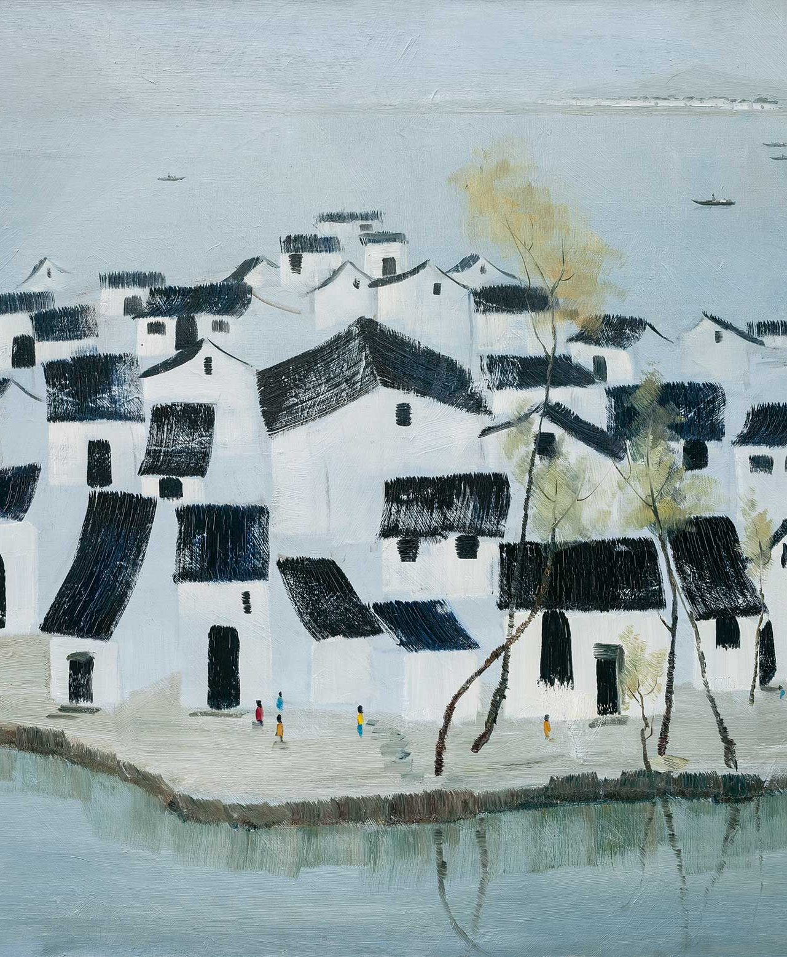
An oil painting is an image, but is NOT a photograph

Slide 9
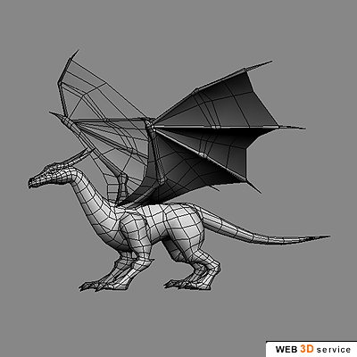
Am Image of 3D Model

Slide 10
What is an Image
An Imaging System
Input?
Image

Slide 11
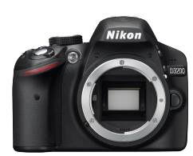
What is a Photograph?
Scene
Photo

Slide 12
Image of 3D Model
Input:
3D Model
File
Imaging System: 3D Render Software

Slide 13

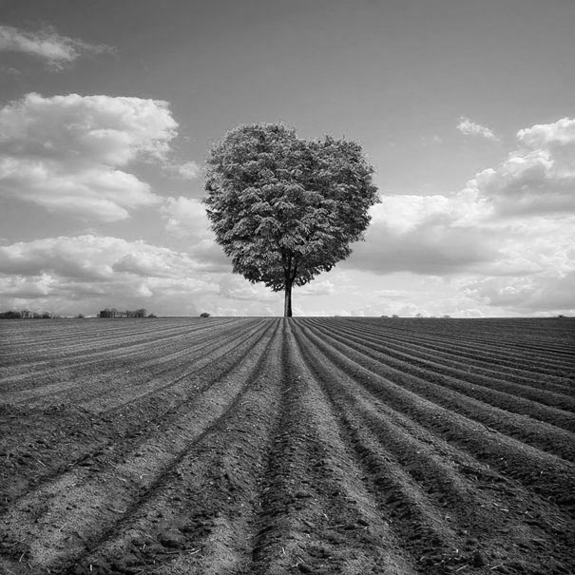
Color Image and gray level image

Slide 14
1.1.1 What is an Image? (Gray Level)
An image can be define as a two-dimensional function f(x,y), where x and y are spatial coordinates, and the value of amplitude or value of f at (x, y) is call the intensity or gray level of f at that point.

Slide 15
Mathematical model of Image
Y
Location:(x,y)
Value:f(x,y)
Origin
X

Slide 16
What is an Color Image
f(x,y) is a vector, for example, [r,g,b]T

Slide 17
1.1.2 What is a Digital Image
When x,y,intensity of f are all finite, discrete quantities, we call the image as Digital Image.
Because the coordinate (x,y) are discrete, so a digital image can be considered as a Matrix or a 2D array.

Slide 18
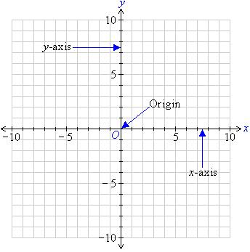
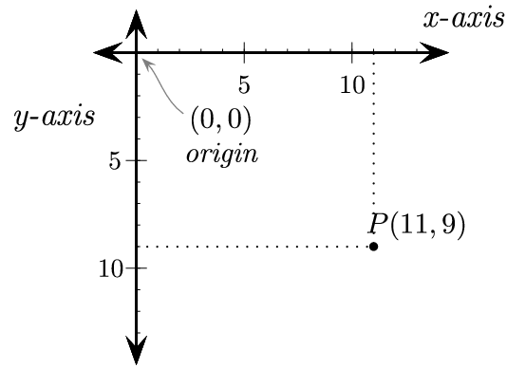
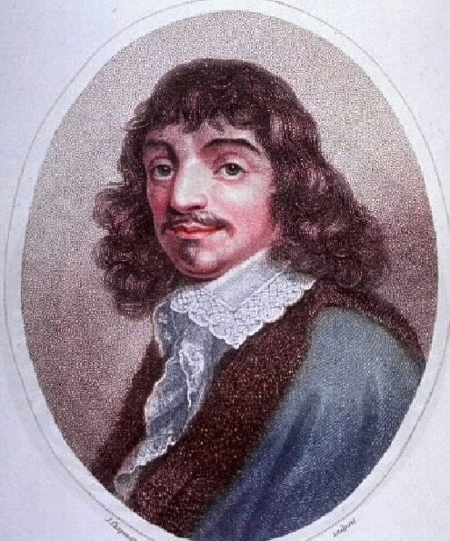
Carte’sian coordinate system Graphics Coordinate System

Slide 19
1.1.2 What is a Digital Image
Gray level digital image:2-D byte array
Range of byte: [min max]
Min: Black
Max: White
[Programming of “Hello, Image”]
[Introduction to C--]

Slide 20
1.1.3 Pixel
Pixel can be see the element of picture or image.
Each pixel has a particular location ((x,y) coordinate) and value(intensity or color)
[Programming: How to access pixel, read and write operation]

Slide 21
1.1.3 Pixel

Slide 22
1.1.3 Pixel
A0 | A0 | A0 | A0 | A0 | A0 | A0 | A0
A0 | A0 | A0 | A0 | A0 | A0 | A0 | A0
A0 | A0 | 0 | 0 | 0 | 0 | A0 | A0
A0 | A0 | 0 | 0 | 0 | 0 | A0 | A0
A0 | A0 | 0 | 0 | 0 | 0 | A0 | A0
A0 | A0 | 0 | 0 | 0 | 0 | A0 | A0
A0 | A0 | A0 | A0 | A0 | A0 | A0 | A0
A0 | A0 | A0 | A0 | A0 | A0 | A0 | A0

Slide 23

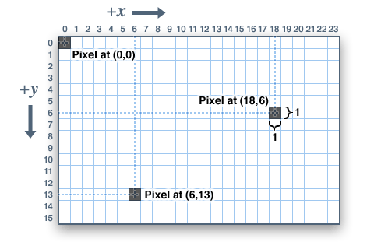
1.1.3 Pixel

Slide 24
1.1.4 Image Resolution
Logic Resolution, Image Size:
How many pixels in a image

Slide 25
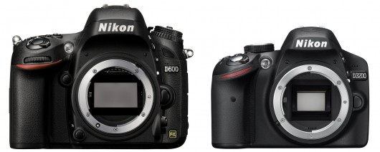
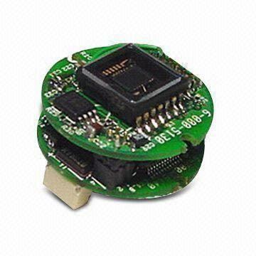
Camera Sensor Resolution
Resolution: 2 megabyte pixels

Slide 26


Screen Resolution
VGA resolution: 640 X 480
HD resolution: 1920 X 1080

Slide 27
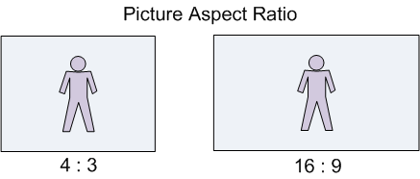
Aspect Ratio
Aspect Ratio = width / height
2 megabyte pixels = 1600X1200

Slide 28
1.1.4 Image Resolution
[Programming: Image Size]
(f.GetLegth(0)-1,0)
(0,0) | (1,0)
(0,1) | (1,1)
(f.GetLength(0)-1,f.GetLength(1)-1)
(0,f.GetLegth(1)-1)

Slide 29
1.2 What is Digital Image Processing
Digital image processing means processing digital images by means of digital computers.
Processing System
input
output
Digital Image
Processing System
Input:f(x,y)
Output:g(x,y) or ？

Slide 30
1.3 Applications of Image Processing
1.3.1 Low Level Image Processing
Spatial Transforms
[Demo of same picture view software]

Slide 31
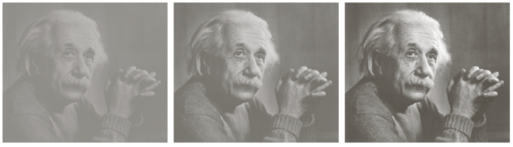
Image Enhancement
To get a better image

Slide 32
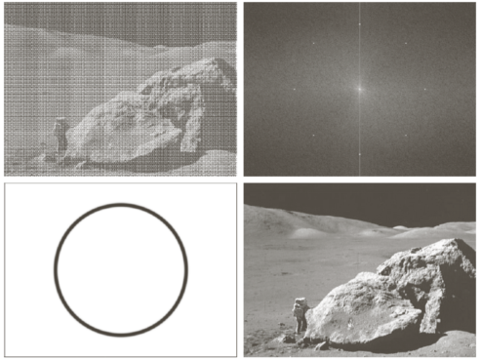
Image Restoration
To get more “real” image （9.30）

Slide 33
1.3.2 Image Compression
Why we need this Technology
The amount data of image or video may be extremely huge

Slide 34
1.3.2 Image Compression
The amount data of 2 hour of SD Video.
SD means Standard Definition, resolution is 720X480
to storage a pixel of color image need 3bytes.
One second data is
720X480 (resolution)X 3 X 30(frames/sec) = 31,104,000 bytes
total amount is
31,104,000 X 3600 (sec/h) X 2 = 2.24 X 10 to power of 11 bytes
or 224 GB (gigabyte)

Slide 35
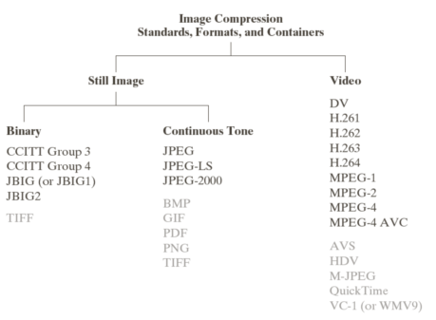
1.3.2 Image Compression

Slide 36
1.3.2 Image Compression
Data Compress：entropy coding， lossless compression
Image Compress ：DCT， entropy coding，ext, lossy compression

Slide 37
1.3.3 computer vision or machine vision
Use computer and image sensor to emulate human vision
What is Where
What means recognition
Where means Scene Analysis or (Scene Reconstruction)

Slide 38
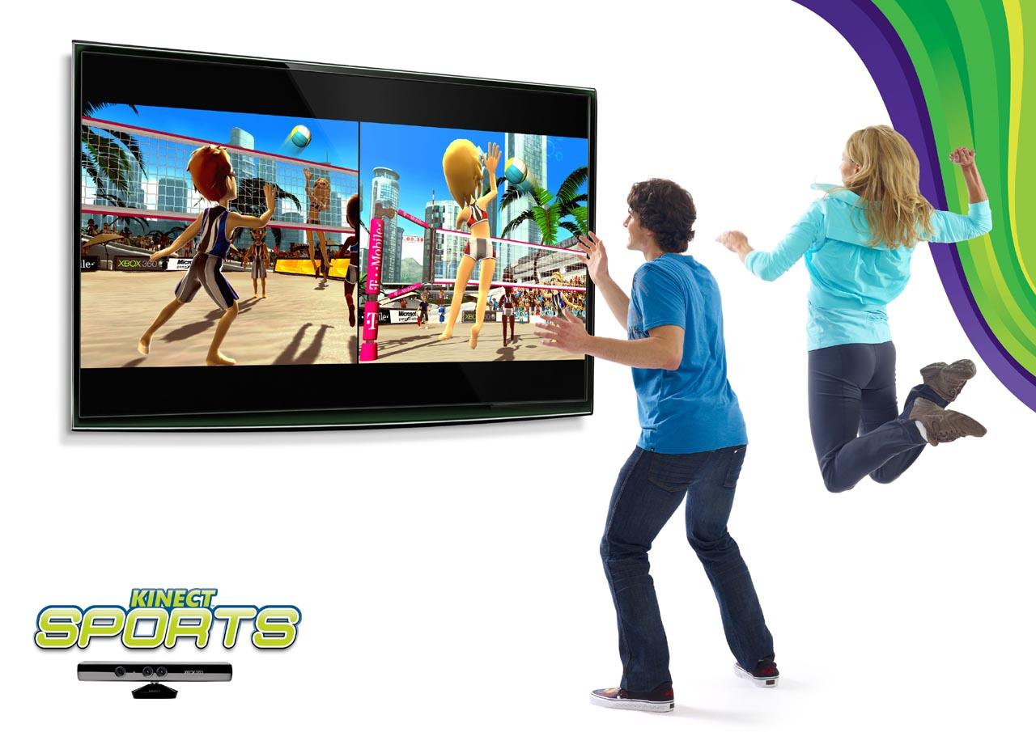
1.3.3 computer vision (Microsoft)

Slide 39
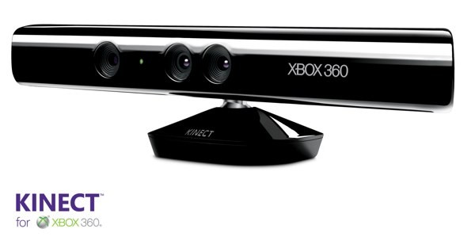
computer vision (Microsoft)

Slide 40
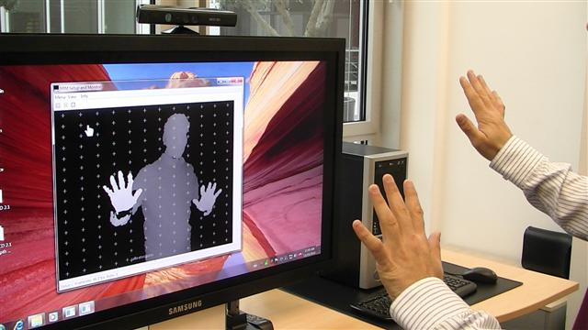
computer vision (Microsoft)

Slide 41
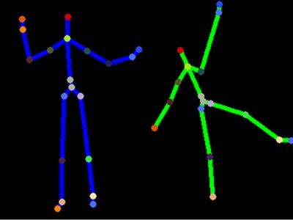
computer vision (Microsoft)

Slide 42
Computer Vision
Low-level Processing: both input and output are images
➢Mid-level Processing: input images, output attributes of those images
Image Segmentation Image Indexing (Feature Extraction)
➢High-level Processing: related to computer vision
Image Analysis and Understanding

